Slide 1

IMS for an online bar service
Jade Foster

Slide 2
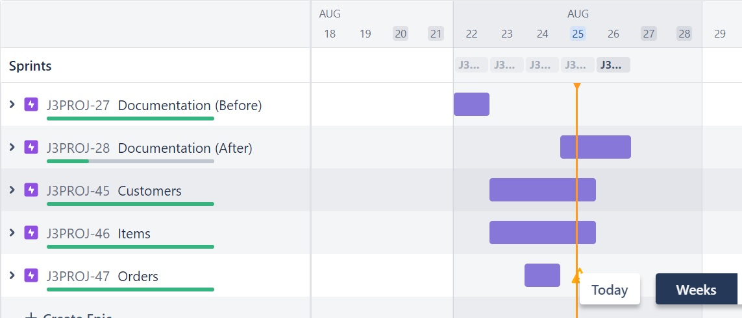
Introduction
- First of all I broke the project into three main sections: Customers, Items and Orders.
- Used this as my 3 epics for the project, associated them with user stories and then broke all the tasks down necessary to do this in a Jira board, and organised them into sprints based on story point estimates.

Slide 3
Introduction
- I knew items would take a similar format to customers, but orders would be more complicate due to the many to many relationship, so we have to keep track of not just the orders but the items in the orders too
- So I began by creating my SQL schema and initial data, choosing the context of an online bar service, so customers could make orders and staff could keep track of them.

Slide 4
Consultant Journey
What technologies have you learned for this project?
- This project uses Java, SQL, GitHub and JUnit

Slide 5
CI
How did you approach version control?

Slide 6
Testing
What was tested? Show the coverage of the src/main/java folder

Slide 7
Demonstration – User Story 1

Slide 8
Demonstration – User Story 2

Slide 9
Demonstration – User Story 3

Slide 10
Sprint Review
What did you complete? What got left behind?
Sprint 0 – Completed initial documentation, Jira board and created database tables
Sprint 1 –
Sprint 2 –
Sprint 3 –
Sprint 4 –
Sprint 5 -

Slide 11
Sprint Retrospective
What went well? What could be improved?
Sprint 0 – Created detailed epics, stories, tasks and acceptance criteria. However risk assessment is not yet complete and is going to be updated as the project goes on.
Sprint 1 –
Sprint 2 –
Sprint 3 –
Sprint 4 –
Sprint 5 -

Slide 12
Conclusion

Slide 13
Thank you for listening!
Any questions are welcome

